Slide 1




Federated Few-shot Learning for Mobile NLP
The 29th Annual International Conference On Mobile Computing And Networking
Dongqi Cai¹, Shangguang Wang¹, Yaozong Wu¹, Felix Xiaozhu Lin², Mengwei Xu¹
1 Beiyou Shenzhen Institute
2 University of Virginia
Notes:
Okay, now here is our second work on practical NLP: Federated Few-shot Learning for Mobile NLP.

Slide 2



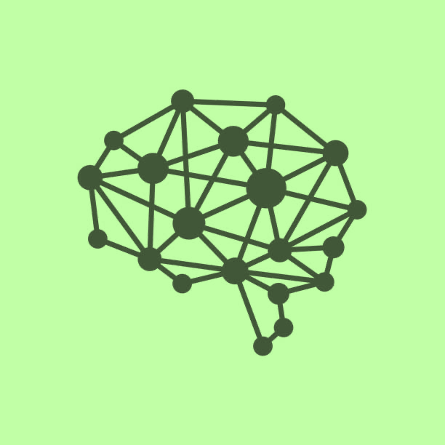

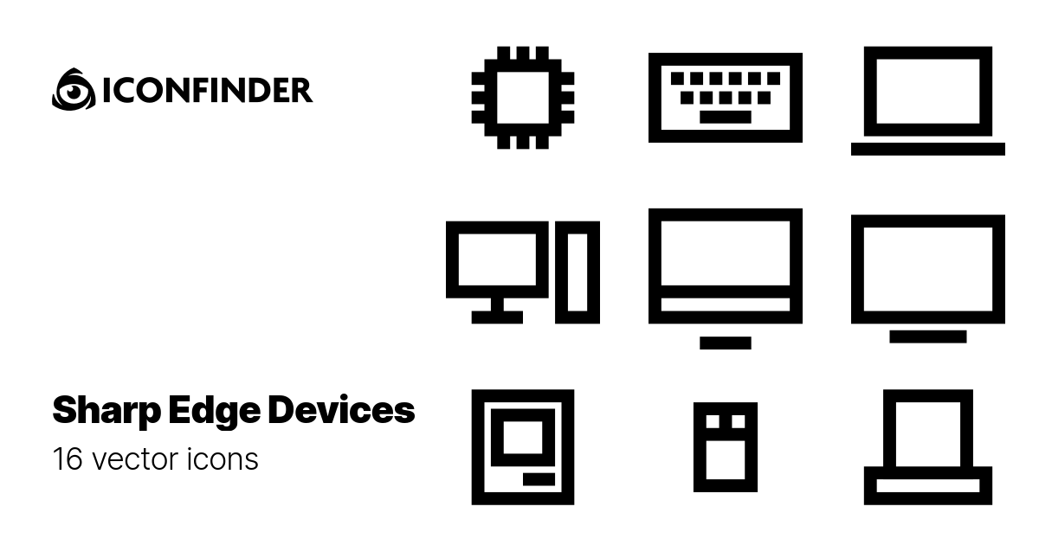
Where is the training data coming from?
FedNLP: focus of our work
Text Clssification.
BERT, DistilBERT, BART, GPT, etc
Fine-tuning
Seq. Tagging
Fine-tuning
…
Deployment
…
Pre-training
Text Generation.
Fine-tuning
…
Private, geo-distributed
Public, centralized
Cloud
Cloud&Clients
Clients
EuroMLSys’23:
Towards Practical FedFSL
Dongqi Cai (蔡栋琪) @ CS Dept of BUPT
1
Notes:
I'm sure you could still recall the workflow of how transformer-based NLP models are trained. //
Our first work, focused on optimizing the second step, which is the federated fine-tuning of NLP models. //
Now let’s ask one more question?
Where is the training data coming from.

Slide 3












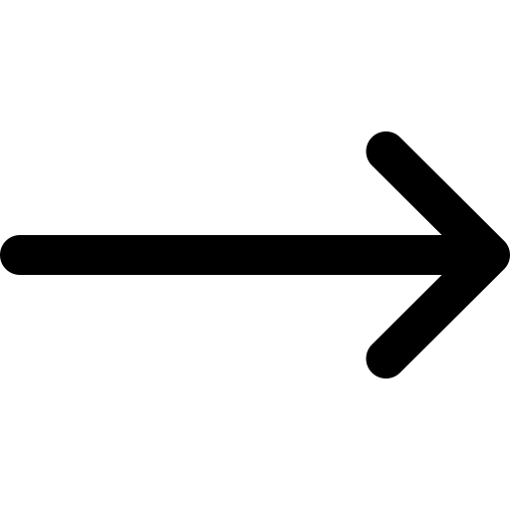
Well-curated labeled data is scarce on mobile devices
Background: Federated Few-shot Learning (FedFSL)
Mouse
Users lack willingness.
Users lack expertise.
Diverse NLP tasks.
Mislabels are common.
Notes:
For sure, the training data is stored privately on our mobile clients – that's precisely what federated learning addresses. // But, we're faced with an even greater challenge: the need for data labels. //
Here's why it's a challenge:
First, studies indicate that most users are reluctant to label their data. //
And second, labeling data requires domain-specific knowledge, most users simply don't have it. //
Third,// as diverse NLP tasks continue to emerge, it becomes impractical to ask users to label data for every new application. //
And let's not forget: to error is human.. Given that labels from end-users are almost impossible to verify, we risk a higher ratio of mislabels, which can severely degrade the quality of our models. //
So in this work, we hold an strong assumption that most of clients do not own data labels, that is we will only initiate fewer than 100 labels in total for training.
For the vast amounts of unlabeled data, we employ self-supervised pseudo labeling to utilize them. //
---
（ While prior ML research tackled training with scarce labels (referred to as few-shot scenarios), the mobile environment exacerbates such scarcity.
---
Fine-tuning pre-trained models for downstream NLP tasks often requires tremendous amount of data that is both private and labeled. However, Well-curated labeled data is scarce on mobile devices. (Motivation for FedFSL)
Enormous unlabelled data is frozen/untouched on model devices. (Motivation for Pseudo Label)
Pre-trained models embeds enrich knowledge for text understanding. (Motivation for Prompt Learning)
---
This is because each sample is accessible to only one client user who can label it, and most users are reluctant to label their data.
So, we assume a key obstacle to practical Federated NLP is the lack of 'labeled data, which we refer to as Federated Few-Shot Learning.
Apart from the lack of labels, those surviving labels could be skewed distributed in few clients because only part of clients is willing to label their data for training.
To tackle this challenge, we introduce pseudo labels, the popular method in central self-supervised learning.
After receiving an aggregated model from the server, a mobile client may run inference on all its unlabeled data for pseudo labeling. With pseudo-labeling, all trainers in federated learning could be the data labelers of themselves.
However, the pseudo-labels generated by weak models are prone to errors and may hurt the training instead of helping. To address this issue, we introduce prompt learning, a powerful NLP technique that adds task description for NLP tasks, commonly used in few-shot NLP scenarios.
Based on these two techniques, we propose Augmented FedPrompt, a prompt-based federated learning system that exploits abundant unlabeled data for data augmentation. Our experiments indicate that our system can perform on par with full-set fine-tuning with only a limited amount of labeled data.
---
Because Each sample is accessible to only one client user who can label it. Reports show that most users are reluctant to label their data [21, 82]. This is fundamentally different from traditional centralized or crowdsourced data labeling services that can recruit highly specialized data labelers [42].
Data labeling for certain NLP tasks require domian-specific knowledge, which most users do not possess. In some case, they might even mislabel and mislead the training.
A key obstacle to practical Fedederated NLP is lack of labels. We refer it as federated few-shot learning.
Apart from the lack of labels, those surviving labels could be skewed distributed in few clients because only part of clients are willing or knowledgeable to label their data for training.
To tackle this challenge, we introduce pseudo labels, the popular method in central self-supervised learning.
After receiving an aggregated model from the server, a mobile client may run inference on all its unlabeled data for pseudo labeling.
Integrated with pseudo labeling, all trainers in federated learning could be the data labelers of themselves.
The second challenge is pseudo labels generated by weak models are prone to be error and will hurt the training instead of helping.
So we further introduce prompt learning, a powerful NLP technique that add task description for NLP tasks, so as to boost accuracy in model fine-tuning, which is commonly used in few-shot NLP scenarios.
Based on those two techniques, we propose augmented fedprompt, a prompt-based federated learning system that exploits abundant unlabeled data for data augmentation. Our experiments indicate that augmented fedprompt can perform on par with full-set fine-tuning with a limited amount of labeled data.
---
As a result,
(4). Mislabels are not uncommon.
Unexplored: fine-tuning is often few-shot. While training samples on clients can be abundant, the labeled ones are often scarce. To exacerbate the problem, the numbers of labels could vary drastically across clients. Such skewed label distribution, combined with the non-IID data distribution nature in FL (e.g., skewed class distribution [43, 86]), could further degrade the fine-tuning accuracy. The causes for label scarcity are fundamental. • Users lack willingness. Each sample is accessible to only one client user who can label it. Reports show that most users are reluctant to label their data [21, 82]. This is fundamentally different from traditional centralized or crowd-sourced data labeling services that can recruit highly specialized data labelers [42]. • Users lack expertise. Data labeling for certain NLP tasks require domian-specific knowledge, which most users do not possess, e.g., cross-lingual transfer [54], Q&A [84], or biomedical text corpora understanding [94]. • Diverse NLP tasks. Downstream tasks are emerging over time, e.g., new domains, topics, or data distributions. Asking users to label a large amount of data for each task is tedious, inefficient, and impractical. • Mislabels are not uncommon. Mislabels are common in real world, e.g., 6% in the well-established ImageNet or even more than 10% in other crowd-sourced datasets [51]. In FedFSL, since the labels from end users are merely impossible to be verified, we expect an even higher ratio of mislabels, which can significantly harm the model quality. Instead, trainers might only use the labels from very few, highly trustworthy people. In essence, we argue that few-shot is a more realistic way to depict NLP training, a scenario we call as FedFSL. Unfortunately, FedFSL, in particular its system implications, are rarely investigated – in comparison, prior FL literature assume abundant data labels (at least hundreds of thousands) uniformly distributed across clients.

Slide 4
Background: Pseudo labeling
The rational behind pseudo labeling:
“Training with pseudo labels encourages the model to learn a decision boundary that lies in a region where the example density is lower. ”
Data without labels
Data with pseudo labels
Local Model
For example,
“great”:0.9, “bad”:0.1 rather than “great”:0.6, “bad”:0.4
Low class overlap Low entropy
Notes:
First, let me introduce pseudo labeling quickly.//
During the training phase, the trainer utilizes the current model to make predictions on unlabeled data. These predictions are then treated as "true" labels for the next training iterations.
(Both empirical evidence and theoretical analysis have showcased the effectiveness of this approach. //
---
The idea behind it, is that training with pseudo labels encourages the model to learn a decision boundary that lies in a region where the example density is lower. This decision boundary typically leads to good generalization performance, even though the true labels of individual samples remain unknown.
For example, the resultant model assigns a high probability zero point nine to positive label "great" rather than a lower probability zero point six, which in turn encourages low entropy.

Slide 5
Background: Prompt learning
■ T1 (label = +1): “Most delicious pizza I’ve ever had.”
■ T2 (label = -1): “You can get better sushi for half the price.”
■ T3 (label = ?): Pizza was good. Not worth the price.
Prompt
"It was <MASK>. Pizza was good..."
It was <MASK>.
Pizza was good..."
Forward
Backward
Upgrade
Input Text
Pizza was good…
+1
Pre-trained Model
Fine-tuned Model
Loss
Label
+1: 0.8
great: 0.8
Local Prompt Training
-1: 0.2
terrible: 0.8
Notes:
The second technique we will utilize is prompt learning. (, a powerful NLP technique that improves the accuracy of model fine-tuning, which is commonly used in few-shot scenarios.
Brifly, the insight of prompt learning is that the foundation model// already encodes knowledge// for performing various tasks;// it just needs a prompt// that describes what the task is.
More descriptions about those two techniques could refer to our paper.
And in the rest of our paper, we will train the model in such a prompt way.
---
Briefly, Let's suppose we fine-tune a foundation model to classify restaurant reviews and are given only two labeled samples.
The first sample is "Most delicious pizza I’ve ever had." and is positively labeled, while the second sample "Pizza was good. Not worth the price." is negatively labeled.
With such a small number of labeled samples, training a usable classification layer is impossible.
Consider an unlabeled example:
“Pizza was good. Not worth the price.”
The model may positively predict the unlabeled example’s class if the task is to classify user satisfaction, or negatively if the task is about whether price is mentioned. But without such a task description, the model can only randomly guess and generate an error pseudo label.
To fix the problem, the insight of prompt learning is that the foundation model already encodes knowledge for performing various tasks; it just needs a prompt that describes what the task is.
More formally, a cloze question is called a pattern and the mapping from words to classes is done by a verbalizer.
The training loss is the cross-entropy between the correct answer and the distribution of probabilities among the tokens in the verbalizer.
---
Second technique is prompt learning. It’s a powerful NLP technique that boosts accuracy in model fine-tuning, which is commonly used in few-shot scenarios.
For Federated Few-shot learning, we find prompts crucial to the early stage of a training sessions, when the model is weak and can barely generate useful pseudo labels
For example, suppose we fine-tune a foundation model to classify restaurant reviews and are only given two labeled samples.
First sample: “Most delicious pizza I’ve ever had.”is positively labeled. While the second sample “Most delicious pizza I’ve ever had.”is negatively labeled.
With such few samples, training a usable classification layer is impossible. Consider an unlabeled example:
“Pizza was good. Not worth the price.”
The model may positive predict the unlabeled example’s class probabilities if the task is to classify user satisfaction, or negatively if the task is about whether price is mentioned. But without such a task description, the model can only randomly guess and generate an error-prone pseudo label.
To fix the problem, the insight of prompt learning is that the foundation model already encodes knowledge for performing various tasks; it just needs a prompt that describes what the task is.
The cloze-style phrases is exactly what the foundation model was pre-trained for, that is to predict missing words in text.
More formally, a cloze question is called a pattern and the mapping from words to classes is done by a verbalizer.
The training loss is the cross-entropy between the correct answer and the distribution of probabilities among the tokens in the verbalizer.
---
With such few samples, training a usable classification layer is impossible. Consider an unlabeled example:
In the example above, if ML developers augment all samples with a leading prompt, e.g. T3 becomes:

Slide 6
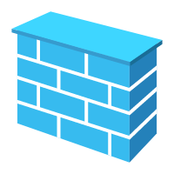

System model
Pseudo-labeled Data
Labeled Data
Unlabeled Data
Next Iteration
…
…
…
…
…
Aggregated model
…
…
Clients
Pseudo Labeling
…
…
…
…
…
…
It was <MASK>.
Pizza was good..."
Forward
Backward
Upgrade
Input Text
Pizza was good…
+1
Pre-trained Model
Fine-tuned Model
Loss
Label
+1: 0.8
great: 0.8
Local Prompt Training
-1: 0.2
terrible: 0.8
Notes:
Here is our system workflow orchestrating (/ˈɔːrkɪstreɪtɪŋ/) pseudo labeling and prompt learning.
Firstly, clients conduct local prompt learning.
The clients then send their fine-tuned models to the cloud for aggregating, and the cloud sends back the aggregated model to the clients.
These clients can leverage the received model to do pseudo labeling on their unlabeled data.
( They add the data with the highest confidence as training samples for next iteration.
--
Here is our system orchestrating (/ˈɔːrkɪstreɪtɪŋ/) pseudo labeling and prompt learning.
First, each client having labeled training data do local training via prompt learning without sharing data.
Then they send the fine-tuned models to the cloud for federated average aggregating.
The aggregated model is sent back to all clients, even they do not attend last round training, that is, they do not have training labels though.
Clients leverage the received model to do pseudo labeling on all their unlabeled data. The data with the highest confidence are added as training samples.
In subsequent training rounds, pseudo labels are treated equally as the manually annotated labels.
---
FedPET for real-world few shot text classification.
AUG-FedPrompt: Prompt-Based FedNLP together with Unlabeled Data Augmentation
把prompt 和 unlabeled data

Slide 7
Preliminary: FedFSL performance
Satisfactory accuracy
Pseudo labeling
Prompt learning
How about the system cost?
Notes:
Such a sophiscated workflow, we will call it as Vanilla FedFSL, achieves satisfactory accuracy with scarce data labels; for which// both pseudo labeling and prompt learning are indispensable.
Now it’s happy to see the accuracy performance has a good solution.
However, how about the system cost? Is it practical?
there is still a big step to make because we introduce too much heavy stuffs:
And we
First, Self-supervised pseudo labelling will continuously do marvelous inference on all unlabeled data, that will cost a lot.
And second, prompt leaning needs to be operated on a strong large language model to fullfill its potential.
Third, such a training-inference orchestration is too sophisticated, which is too hard to operate for our system,.

Slide 8
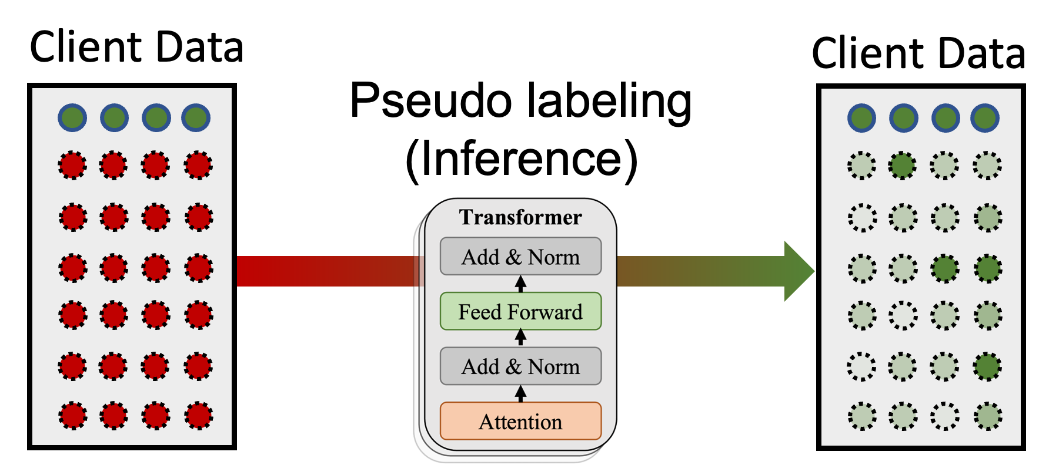
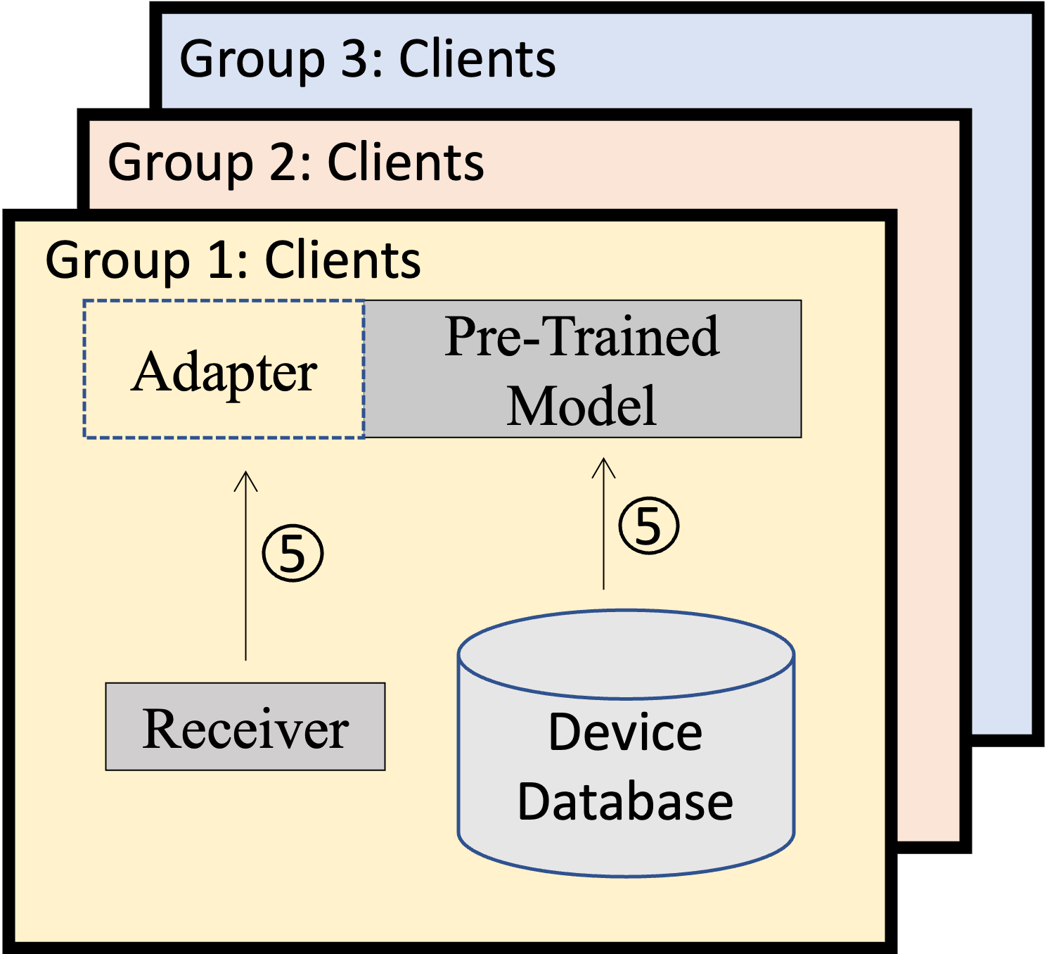
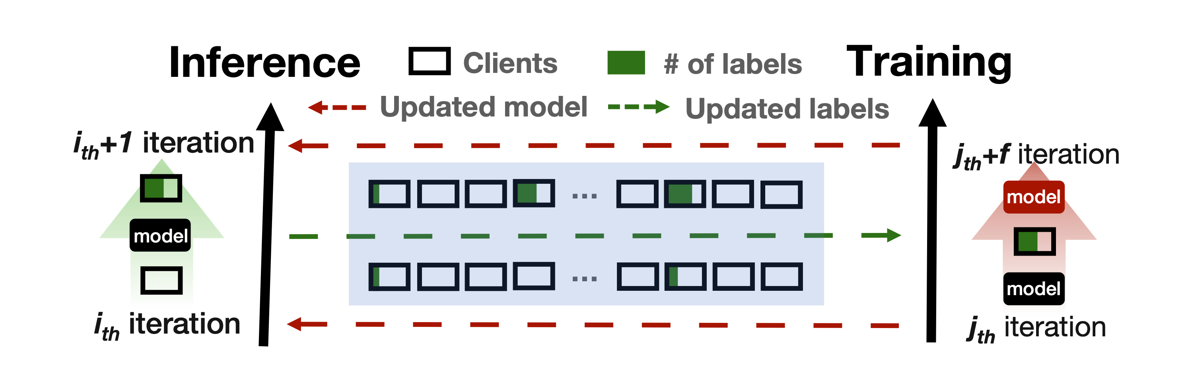
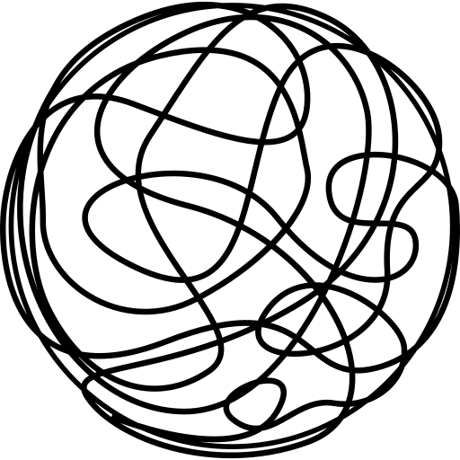
Challenge: FedFSL system cost
Labeling redundancy
Training efficiency
>87%
Adapter
LoRA
Labeling-training pace
Number?
BitFit
…
…
Time?
…
Frequency?
AdaFL: Efficient FL
FeS: Train without labels
2021.12
2022.08
2023.03
Notes:
First is about the training, because prompt learning needs to be operated on a strong large language model to full fill its potential.
Fortunately, we have some techniques for that//
such as parameter efficient tuning// and the efficient tuning configurator// that is our first work AdaFL.
But if we want to train with only few of data labels, we still have more steps to make, that is pseudo labeling.
So we conduct this follow-up work to further tackle the labeling redundancy problem and the orchestration pace between labeling and training.
---
there is still a big step to make because we introduce too much heavy stuffs:
And we
First, Self-supervised pseudo labelling will continuously do marvelous inference on all unlabeled data, that will cost a lot.
And second, prompt leaning needs to be operated on a strong large language model to fullfill its potential.
Third, such a training-inference orchestration is too sophisticated, which is too hard to operate for our system,.

Slide 9
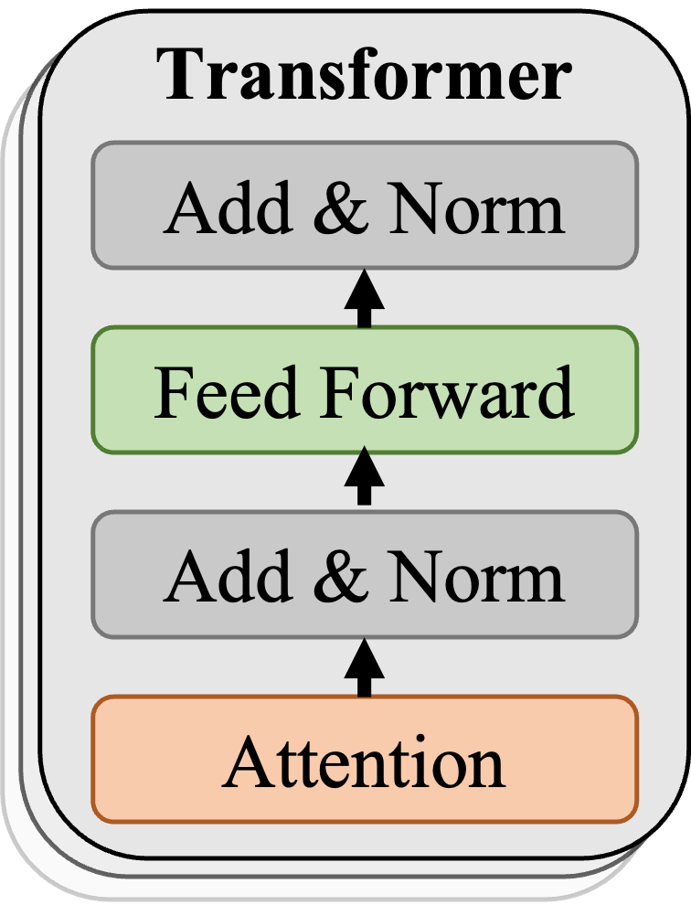






Design: Representational Filtering
Client Data
Client Data
87%
Client Data
Pseudo labeling
(Inference)
In vain
Subsequent
training
?
?
?
?
?
?
?
?
?
?
?
?
?
?
?
?
?
?
?
?
?
?
?
?
Confidence > threshold ?
Subsequent
training
Proxy model
Diversity penalty
Labeling
Repr. score
Offline filtering
MobiCom’23: NFS
Notes:
First, let’s dive into how exhaustive the pseudo labeling is.
A client uses the received model to do pseudo labeling on all its local data,// it might have hundreds or thousands to process.
Only those labels with high confidence are kept, // and the rest are considered unlabeled. // This can lead to much wasted effort.
To solve this, we propose to filter out data // that might not help in future training. // We use two measures to help with it: the representation score // and the diversity penalty score. //
By focusing only on promising samples, we eliminate a lot of unnecessary inferences.
---
Furthermore, the proxy model is trained offline and independent from the NLP model to be trained through FedFSL. Therefore, computing the vector representation of each data is one pass and incurs much less cost than performing inference each round.
Moreover, this cost can be further amortized across multiple FedFSL tasks since they share the same representative vectors.
For example, when computing the vector representation of YELP-F [108], it incurs only an additional 8.4% time cost compared to the FedFSL training process.

Slide 10
Design: Curriculum Pacing
f: frequency of updating pseudo labels
n: number of clients selected to perform pseudo labeling
k: ratio of selected pseudo labels for the subsequent training
Pacing configuration <f,n,k>
Progressively speed up the pseudo labeling speed, i.e., adding more pseudo labels at a higher frequency.
Progressive upgrading is only a coarse-grained plan, how to control the pace more concisely?
Notes:
Finally, we seek to simplify the sophisticated training workflow.
We define three key hyper-parameters that highly influence the training performance.
First, that is the frequency of updating pseudo labels, which we call f. // Next, that is the number of clients selected to perform pseudo labeling, and we name this n. // Lastly, we have the ratio of selected pseudo labels for the subsequent training, named as k. //
At the start of FedFSL, our language model isn't that strong and can make mistakes with labels. So, we use smaller f,n,k, to only take the ones we're really sure about. // But as it gets better, it starts wanting more challenging data, so we use bigger f,n,k to include more pseudo-labeled data in the training. //
We call this strategy as curriculum pacing.
Now we have a coarse-grained plan, we still want to control the pace more concisely.

Slide 11
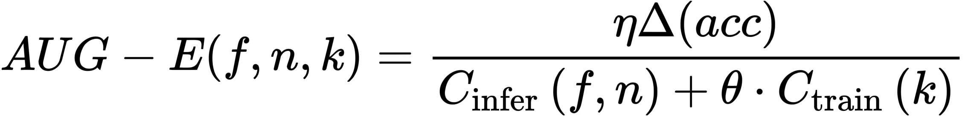

Design 3: Curriculum Pacing
f: frequency of updating pseudo labels
n: number of clients selected to perform pseudo labeling
k: ratio of pseudo selected labels for the subsequent training
Augment efficiency (AUG-E):
a new metric to measure the efficiency of each pacing configuration.
Our system selects a configuration with best AUG-E from a candidate list (hand-picked through extensive offline experiments) for future pseudo labeling.
Notes:
So we come up with a new metric to measure the efficiency of each pacing configuration.
We call it "augment efficiency," or AUG E for short.
AUG-E helps us see how much accuracy improvement our system is getting and how much it costs to get there. The higher the AUG-E, the more accuracy benefit is brought in a more efficient way.
Our system will select a configuration with best AUG-E for future pseudo labeling
---
measure the gradient of the time-to-accuracy curve to search for an effective configuration with low cost
---
In order to find a concrete efficient pace with low system cost, we define a new metric, namely augment efficiency (AUG-E), to measure the efficiency of each pacing configuration.
It actually measure the gradient of the time-to-accuracy curve, that is how much cost is paid for the accuracy improvement.
Higher the AUG-E, more accuracy benefit is brought in a more efficient way.
Our system selects a configuration with best AUG-E from a candidate list for configurating future pacing.
According to our experiments, the most effective configurations with higher accuracy and smaller training time would obtain a relatively higher AUG-E score in the early stage of searching.
---
Describe this quickly and

Slide 12
Evaluation: Setup
Implementation
FedNLP^{[1]}
PET^{[2]}
Setups
2 devices (TX2, RPI 4B)
2 models (RoBERTa-base & large)
4 datasets
Baselines
Vanilla Fine-Tuning (FedCLS)
Vanilla Few-shot Tuning (FedFSL)
Vanilla Few-shot Tuning + Bias-tuning (FedFSL-BIAS)
64 labels in total instead of per client
[1] Yuchen Lin B, He C, Zeng Z, et al. FedNLP: Benchmarking Federated Learning Methods for Natural Language Processing Tasks[J]. Findings of NAACL, 2022.
[2] Schick T, Schütze H. Exploiting Cloze-Questions for Few-Shot Text Classification and Natural Language Inference[C]//Proceedings of the 16th Conference of the European Chapter of the Association for Computational Linguistics: Main Volume. 2021: 255-269.
Notes:
Now is the evaluation part, and the testbed setting is similar to the first work, but there is one big change. In this work, we initiate with only sixty-four data labels for training, with most of data being unlabeled.
---
To gain better accuracy performance, we use a larger language model RoBERTa-large and compare to some few-shot learning baselines.
We're using a bigger model called RoBERTa-large. There are two main difference, we use a larger model RoBERTa-large, and instead of assuming all data with labels, we switch to a few-shot setting, that is only 64 labels
---
our system atop the open-sourced repository FedNLP [47] and PET for easy reproduce.
Our experiments are carried out in an emulation manner on GPU servers and two development boards with similar hardware capacity to mainstream mobile devices.
We evaluate our system on four NLP datasets and two models compared to three baseline
(, including vanilla fine-tuning, heavy few-shot tuning and heavy few-shot tuning optimized by origin.

Slide 13
Evaluation: End-to-end Performance
Our system significantly speeds up model convergence at high accuracy.
46×
68.0%
Table 1: The final convergence accuracy (“Conv. Acc.”) and the elapsed training time (“Time-to-acc”) to reach different relative accuracy. “acc1”/“acc2” are the final convergence accuracy of FedFSL/FedFSL-BIAS, respectively. “X” means the accuracy cannot be achieved.
Notes:
First, we show the end-to-end performance of our system.
Compared to vanilla federated fine-tuning, adapting the pseudo labeling and prompt learning increase the convergence accuracy siginificantly.
Accordingly, the other two baselines that use those two techniques, they also achieve a competitive convergence accuracy. However, Our system is much faster than them.
(For example, on Jetson TX2, Our system takes only 0.1–0.4 hours to reach the convergence accuracy, while other baselines take a few or even dozens of hours to converge.
---
Interestingly, We also observe Our system achieves 3.4%–18.1% higher relative accuracy than FedFSL and FedFSL-BIAS.
We hyphosis that Our system employs curriculum pacing that effectively orchestrates pseudo labeling with federated learning, whereas the two FedFSL baselines use a static pacing strategy that could lead to insufficient or excessive pseudo labels.

Slide 14
Evaluation: Key deign
Our key designs contribute to the results significantly.
13.8×
20.1×
8.0×
62.3×
1.2×
1.3×
1.8×
3.5×
3.5×
2.6×
1.6×
2.9×
Fig. 1: Model convergence delays with and without Our system’s key designs, showing their significance. DC: training depth/capacity co-planning; RF: representative filtering; CP: curriculum pacing.
Notes:
We also perform an ablation study to understand the contribution of each key technique of Our system.
As shown in the Figure, The efficient training technique could reduce the convergence time by up to 60 times on different datasets. ((The significant improvement comes from that most of bottom layers (up to 66.7% on AGNEWS) are skipped, which reduces the training latency linearly. Some middle layers are tuned with reduced capacity, and thus reduces the network traffic.
The representative filtering mechanism filters out up to 95% of the data. It helps to reduce the convergence time .
Curriculum pacing further reduces it by selecting a low-cost pacing configuration.

Slide 15
Evaluation: System Cost
Our system is resource-efficient.
It saves up to 3000.0× network traffic. (Fig. 1)
It reduces up to 41.2× energy consumption. (Fig. 2)
It reduces the memory usage by 4.5×. (Fig. 3)
Fig. 1: The total network traffic of all clients.
Fig. 3: Memory footprint of on-device training.
Fig. 2: The total energy consumption of all clients, normalized to that of ours
Notes:
We also report the costs of our system in the paper. We look at how efficient it is when it comes to network traffic, energy consumption, and memory usage. For a more detailed analysis, please check out our paper.
---
And we also report the system cost of our system, it is network efficient, energy efficient and memory efficient. Please refer to our paper for the concise analysis.
The last part of our evaluation is the system cost. We report the network traffic, energy consumption and memory usage of our system.
Our system saves three orders of magnitudes times of network traffic compared to vanilla federated few-shot fine-tuning.
Our system can save the energy consumption remarkably as well, it reduces up to 41 times energy consumptions.
This improvement comes from the reduced network transmission time, the reduced on-device training/labeling computations, and the cherry-picked orchestrating pace.
Our training depth and capacity co-planning mechanism can reduce the memory footprint by about four times, which is crucial for practicalllm deployment on mobile devices.
---
For example, FedFSL without optimization will lead to out-of-memory while training RoBERT—large.
In comparison, Our system only requires 2.3 GB memory due to the shallow training depth and greatly saved intermediate activations.

Slide 16
Conclusion
Federated Few-shot Learning for Mobile NLP
Dongqi Cai, Yaozong Wu, Shangguang Wang, Felix Xiaozhu Lin, Mengwei Xu
Contact: cdq@bupt.edu.cn
Our system is a FedFSL framework that enables practical few-shot NLP fine-tuning on federated mobile devices.
It incorporates pseudo labeling and prompt learning to achieve usable accuracy with only tens of data labels.
At system aspect, it proposes several novel techniques, i.e., early filtering unlabeled data, reducing the tuning depth/capacity, and curriculum orchestrate them to address the unique challenge of huge resource cost raised by its algorithmic.
Compared to vanilla FedFSL, Our system reduces the training delay, client energy, and network traffic by up to 46.0×, 41.2× and 3000.0×, respectively.
Code: https://github.com/UbiquitousLearning/FeS
Notes:
So in conlusion
Our system is a FedFSL framework that enables practical few-shot NLP fine-tuning on federated mobile devices.
Our system incorporates pseudo labeling and prompt learning to achieve usable accuracy with only tens of data labels.
At system aspect, we propose three novel techniques, i.e., early filtering unlabeled data, reducing the tuning depth/capacity, and curriculum orchestrating them.
Compared to vanilla FedFSL, Our system reduces the training cost significantly.
---
That’s all, thank you for listening.
And I’ll be happy to answer any questions.

Slide 17








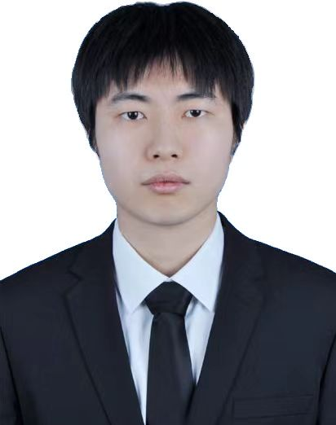


Concluding Remarks by Mengwei
The recent AI wave (large, foundational, multimodal models) is going to make another Golden Era for mobile computing.
Think of Smartphones/IoTs as humans-level assistants
Two key research directions
Making LLMs run fast and learn rapidly on devices (hw-sw-algo. codesign)
Building killer apps atop LLMs (agents, searching, AIGC, etc)
Open to collaboration and debate!
Who are we: a junior faculty plus a group of passionate graduate students who believe in LLM as a game changer to mobile research
Generated by Stable Diffusion XL
Notes:
Okay, my advisor mengwei sent me this last slide to conclude with a few vision of our group.
Basically, we believe that the recent AI wave has the potential to make a new golden era for mobile community, possibly right after the last mobile Internet burst in more than ten years ago. With LLM, smartphones will become as smart as humans to comprehend user intentions and facilitate our dailylife in an open world.
Our group is working on two killer directions relevant: one is to make LLM run efficiently on devices; and the other is to build killer applications atop it. And we are extremely open to collaboration and debate on this vision that many of you might not totally agree with.

Slide 18
Q&A

Slide 19
Different parameter-efficient methods
Adapter is not only for ”adapters”.
Parameter-efficient methods are unified (He, ICLR’22).
Bias-tuning provides the best accuracy-efficiency tradeoff under few-shot learning scenarios (Logan, ACL’22).
He, Junxian, et al. "Towards a Unified View of Parameter-Efficient Transfer Learning.", ICLR 2022.
Logan R L, et al. “Cutting Down on Prompts and Parameters: Simple Few-Shot Learning with Language Models”, ACL 2022.
Notes:
FeS might be more easier to implement, but AdaFL

Slide 20
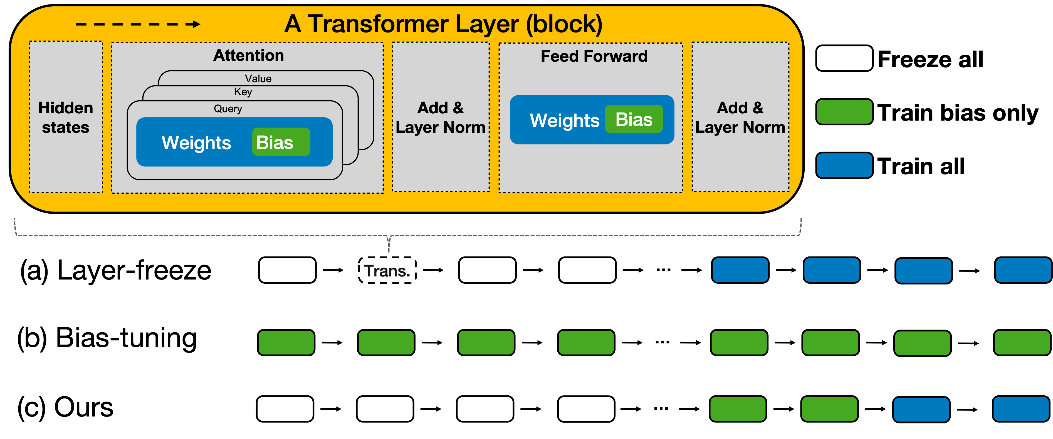
Design 2: Training Depth/Capacity Co-planning
Computation Efficient
Communication Efficient
Comp. and Comm. Efficient
MobiCom’23: NFS
Notes:
The second design aims to boost the training efficiency of LLM. // A common approach is to limit layer depth, // and we refer to this as layer freezing. //
Another common approach is parameter-efficient tuning. // Techniques like adapters, lora, and bias-tuning are all in its scope. // We've picked bias-tuning // because it works well with our few-shot scenarios. //
However, while it's good for saving communication because it's parameter efficient, // it still takes long time for training because it needs a complete forward-backward pass. //
So, what's our solution? // We co-plan the tuning depth and capacity. // We fully train just a few top layers; // adjust only the bias in some middle layers; // and keep the bottom layers frozen. // In this way, we could balance both communication and computation."
---
QA: 选了一种更适合fsl的adapter，adapter是一个general的peft方法
---
The second design is to enhance training efficiency of LLM.
A prevailing method is to limit the depth of the layers. we call it layer freezing
Another popular method is paramerer-efficient tuning, such as adapters, lora and bias-tuning.
We choose bias-tuning for its compatibility with our few-shot scenarios (, other parameter-efficient tuning could also interplay our system and reap benefits.
(Bias-tuning represents a lower tuning capacity for each layer, adjusting only the bias of a layer, which typically represents a meager 0.1% of total weights, whilst maintaining the other weights as frozen.
Though highly communication efficient, the compute time bottlenecks as it still demands a complete forward-backward pass.
We propose to co-plann the tuning depth and tuning capacity: we train very few top layers with full capacity; trains a few middle layers with reduced capacity (i.e., only bias updated); freezes the other bottom layers.
That helps to strike a balance between communication and computation.
(The concrete tuning decision is done offline on cloud.
---
Communication cost has been greatly saved, the runtime bottleneck moves to computation because you still need to go through all the layers one by one the get the gradients of bias weights. It degrades the runtime performance especially when wimpy devices are included. Cause they already compute slow naturally.

Slide 21
Preliminary: FedFSL performance and cost
Satisfactory accuracy
Both pseudo labeling and prompt learning are indispensable.
Huge system cost
Excessive on-device inference.
Prompt learning needs large NLP model.
Sophisticated orchestration workflow.
Notes:
Such a sophiscated workflow, we will call it as Vanilla FedFSL, achieves satisfactory accuracy with scarce data labels; for which// both pseudo labeling and prompt learning are indispensable.
Now it’s happy to see the accuracy performance has a good solution.
However, there is still a big step to make because we introduce too much heavy stuffs:
First, Self-supervised pseudo labelling will continuously do marvelous inference on all unlabeled data, that will cost a lot.
And second, prompt leaning needs to be operated on a strong large language model to fullfill its potential.
Third, such a training-inference orchestration is too sophisticated, which is too hard to operate for our system,.

Slide 22
Paths towards practical federated learning
Curriculum pacing
Activation cache
Solution
Tuning co-planner
Configurator
Representative filter
Key block
Prompt learning
Adapters
Pseudo learning
Challenge
Network transmission
Data labels
AdaFL: Efficient FL
FeS: Few-shot FL
2021.12
2022.08
2023.03

